Slide 1


Tech company
Clinical Natural Language Technology
FOR HEALTHCARE
Cotiviti Technology Solutions Analyst Intern Assessment
Harsita Keerthikanth

Slide 2

Table of
CONTENTS
01
02
03
04
05
Introduction
Historical Background
Evolution of Technology
Current Technologies
Future Prospects
06
07
08
09
10
Strategic Opportunites
Challenges and Threats
Recommendations for Cotiviti
Hackathon POC
Conclusion & References

Slide 3

INTRODUCTION
Importance of NLP in Healthcare
Integration of technologies
NLP
OCR
Computer Vision
LLMs
LMMs
Strategic Opportunities for Cotiviti

Slide 4
Traditional Healthcare Data
Reliance on structured data from EHRs
Easier to process and analyze, limited in capturing all clinical information
Historical
Unstructured Data
BACKGROUND
Most clinical data is unstructured (ex. patient notes, discharge summaries)
Difficult to analyze with traditional methods
Early NLP Systems
Developed to process unstructured clinical text
Rule-based systems required extensive manual effort
Limited scalability and accuracy due to complex medical language

Slide 5

Evolution
OF TECHNOLOGY
Machine learning advancements
Shift from rule-based to machine learning models
Introduction of OCR for digitization
Computer Vision in Healthcare
Linking textual and visual data
Role in comprehensive analysis

Slide 6

Current
Large Language Models (LLMs)
Examples: GPT-4, BERT
Impact on clinical narrative understanding
Multimodal Models (LMMs)
Integration of text and image data
Future applications: diagnostics and personalized care
TECHNOLOGIES

Slide 7
FUTURE PROSPECTS
Integration in Clinical Workflows
Real time decision support
Personalized treatment plans
Predictive analysis
Focus on Actionable Insights
Improving patient outcomes
Reducing healtcare costs

Slide 8




Strategic
OPPORTUNITIES
Enhanced Diagnostics
Leveraging NLP, OCR, computer vision
Improved accuracy in complex cases
Personalized Medicine
Analyzing patient data
Tailored treatments with minimal side effects
Improved Efficiency
Automating routine tasks
Reducing admin tasks

Slide 9
Data Privacy
HIPPA compliance
Privacy risks in NLP model training
Challenges &
Algorithmic Bias
THREATS
Risks of biased datasets
Importance of monitoring and retraining
Integration Challenges
Complexity in implementing new technologies
Infrastructure and training investments

Slide 10
Recommendations
FOR COTIVITI
Invest in research
Focus on advanced NLP and LLM development for healthcare
Explore partnerships
Collaborate with AI-driven healthcare startups
Develop privacy-enhancing technologies
Federated learning and encrypted data training
Moniter and Mitigate Bias
Implement mechanisms to ensure fair and equitable outcomes

Slide 11

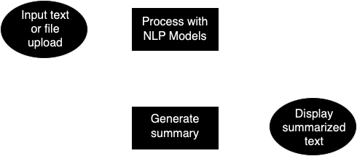



Hackathon POC
PROJECT OVERVIEW
Objective
Enhance healthcare diagnostics and documentation through NLP and OCR technologies
Key Features
Text summarization for clinical notes
File upload capability for summarizing large documents
User friendly interface powered by streamlit
Technologies Used
Python, Streamlit, Hugging Face Transformers, OCR libraries

Slide 12
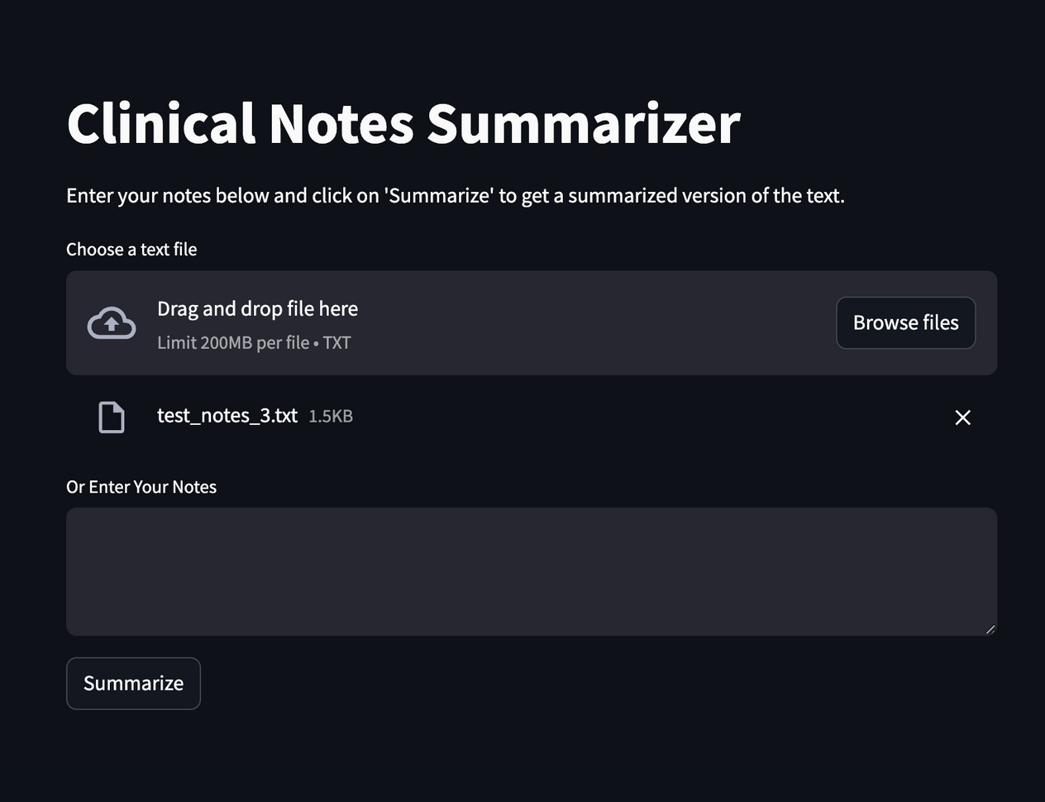
WALK THROUGH AND DEMO
https://clinical-notes-summarizer.streamlit.app/

Slide 13
CONCLUSION
Importance of integrating Clinical NLP, OCR, Computer Vision, LLMs, LMMs
Cotiviti’s strategic positioning for leadership and healthcare analytics
Future-focused approach to technology and patient care

Slide 14
REFERENCES
Agrawal, Monica, and Prateek Jain, 2021
Johnson, Alistair E.W., et al., 2016
Moen, Hans, and Maria Peltonen, 2020
Peters, Matthew E., et al., 2018
Topol, Eric J., 2019
Vaswani, Ashish, et al., 2017

